Slide 1
Vivekanand Education Society’s Institute of Technology
Department of IT
AIDS-2
BE-SEM VII

Slide 2

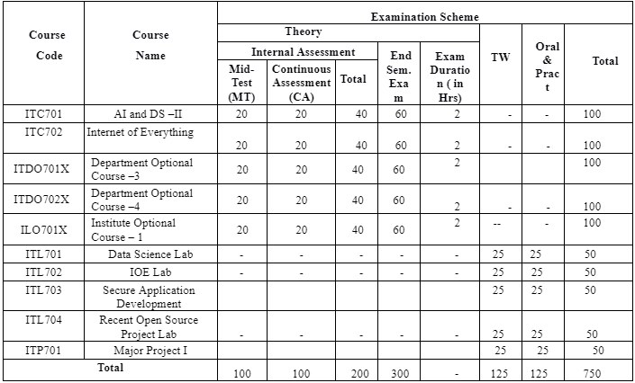
Schema of the Proposed revised syllabus at BE (SEM VII)
Department of Information Technology, BOS meeting 03-07-2023

Slide 3
The Proposed revised syllabus at BE (SEM VII)
Subject Code | Name of subject | Status | Link
ITDO7022 | DLOC 4:AR – VR | Modified the contents by 10-15% | IT_BE_SemVII_DLOC_ARVR
ITDO7023 | DLOC 4:Quantum Computing | Adopted the contents as it is from the syllabus of UoM | IT_BE_SemVII_Quantum Computing
ITDO7024 | DLOC 4:Information Retrieval System | Modified the contents by 10-15% | IT_BE_ SemVII_ DLOC_IR
ILO7011 | ILOC1: Product Lifecycle Management | Adopted the contents as it is from the syllabus of UoM | IT_BE_SemVII_ILOC1_PLM
ILO7013 | ILOC1:Management Information System | Modified the contents by 10-15% | IT_BE_SemVII_ILOC_MIS
ILO7016 | ILOC1:Cyber Security and Laws | Adopted the contents as it is from the syllabus of UoM | IT_BE_SemVII_ILOC1_CSL
ITL701 | Data Science Lab | Modified the contents by 10-15% | BE SEM VII AI &DA II
Department of Information Technology, BOS meeting 03-07-2023

Slide 4
The Proposed revised syllabus at BE (SEM VII)
Subject Code | Name of subject | Status | Link
ITC701 | AI and DS –II | Modified the contents by 10-15% | IT_BE SemVII_ AI &DS- II
ITC702 | Internet of Everything |  | IT_BE_SemVII_IOE_Lab
ITDO7011 | DLOC 3: Storage Area Network | Adopted the contents as it is from the syllabus of UoM | IT_BE_SemVII_DLOC3_SAN
ITDO7012 | DLOC 3:High Performance computing |  | IT_BE_SemVII_DLOC3_HPC
ITDO7013 | DLOC 3:Infrastructure Security | Modified the contents by 10-15% | IT_BE_SemVII_DLOC3_IS
ITDO7014 | DLOC 3:Software Testing and QA |  | IT_BE_SemVII_DLOC3_STQA
ITDO7021 | DLOC 4:MANET | Adopted the contents as it is from the syllabus of UoM | MANET_SYLLABUS
Department of Information Technology, BOS meeting 03-07-2023

Slide 5
Artificial Intelligence and Data Science - II
Sub Code : ITC 701
Sem - VII
Artificial Intelligence ???
Data Science ???

Slide 6
AI : Artificial Intelligence (AI) works by simulating human intelligence through the use of algorithms, data, and computational power.
DS : Data science is the study of data to extract meaningful insights for business. It is a multidisciplinary approach that combines principles and practices from the fields of mathematics, statistics, artificial intelligence, and computer engineering to analyze large amounts of data

Slide 7
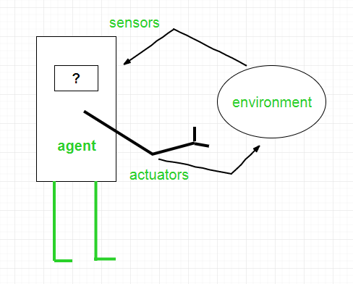
Agent in AI
Agent in AI :- an agent is a computer program or system that is designed to perceive its environment, make decisions and take actions to achieve a specific goal or set of goals

Slide 8
Structure of an AI Agent :-
AI Agent = Architecture + Agent Program
Architecture is the machinery that the agent executes on. It is a device with sensors and actuators, for example, a robotic car, a camera, and a PC.
An agent program is an implementation of an agent function. An agent function is a map from the percept sequence(history of all that an agent has perceived to date) to an action.

Slide 9
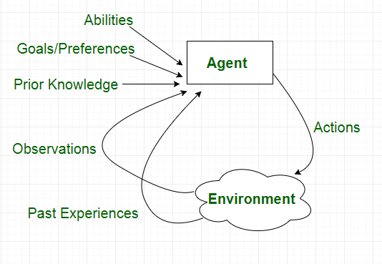
Characteristics of Agent :-

Slide 10
Search Techniques/Search Algorithm
Search algorithms are one of the most important areas of Artificial Intelligence.
1> Informed Search
2> Uninformed/ Blind Search

Slide 11
Search Algorithm Terminologies:
Search: Searchingis a step by step procedure to solve a search-problem in a given search space. A search problem can have three main factors:
Search Space: Search space represents a set of possible solutions, which a system may have.
Start State: It is a state from where agent begins the search.
Goal test: It is a function which observe the current state and returns whether the goal state is achieved or not.
Search tree: A tree representation of search problem is called Search tree. The root of the search tree is the root node which is corresponding to the initial state.
Actions: It gives the description of all the available actions to the agent.
Transition model: A description of what each action do, can be represented as a transition model.
Path Cost: It is a function which assigns a numeric cost to each path.
Solution: It is an action sequence which leads from the start node to the goal node.
Optimal Solution: If a solution has the lowest cost among all solutions.

Slide 12
Properties of Search Algorithms:
1> Completeness: A search algorithm is said to be complete if it guarantees to return a solution if at least any solution exists for any random input.
2> Optimality: If a solution found for an algorithm is guaranteed to be the best solution (lowest path cost) among all other solutions, then such a solution for is said to be an optimal solution.
3> Time Complexity: Time complexity is a measure of time for an algorithm to complete its task.
4>Space Complexity: It is the maximum storage space required at any point during the search, as the complexity of the problem

Slide 13
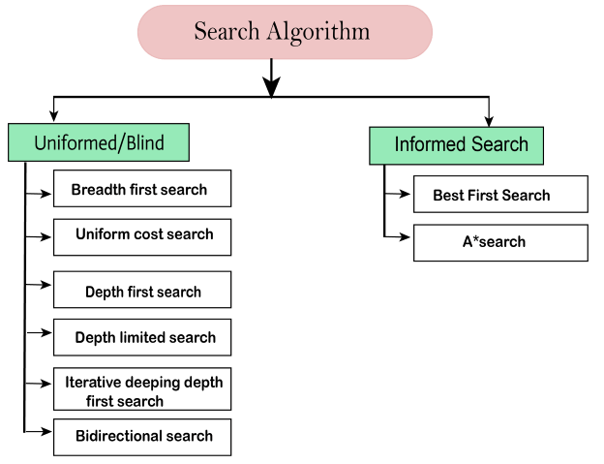
Types of search algorithms
Based on the search problems we can classify the search algorithms into uninformed (Blind search) search and informed search (Heuristic search) algorithms.

Slide 14
Uninformed/Blind Search
Uninformed/Blind Search:-
1)The uninformed search does not contain any domain knowledge
2) It operates in a brute-force way
It can be divided into five main types:
Breadth-first search
Uniform cost search
Depth-first search
Iterative deepening depth-first search
Bidirectional Search

Slide 15
Informed Search
Informed Search
Informed search algorithms use domain knowledge
In an informed search, problem information is available which can guide the search.
Informed search strategies can find a solution more efficiently than an uninformed search strategy
An example of informed search algorithms is a traveling salesman problem.
Greedy Search
A* Search

Slide 16
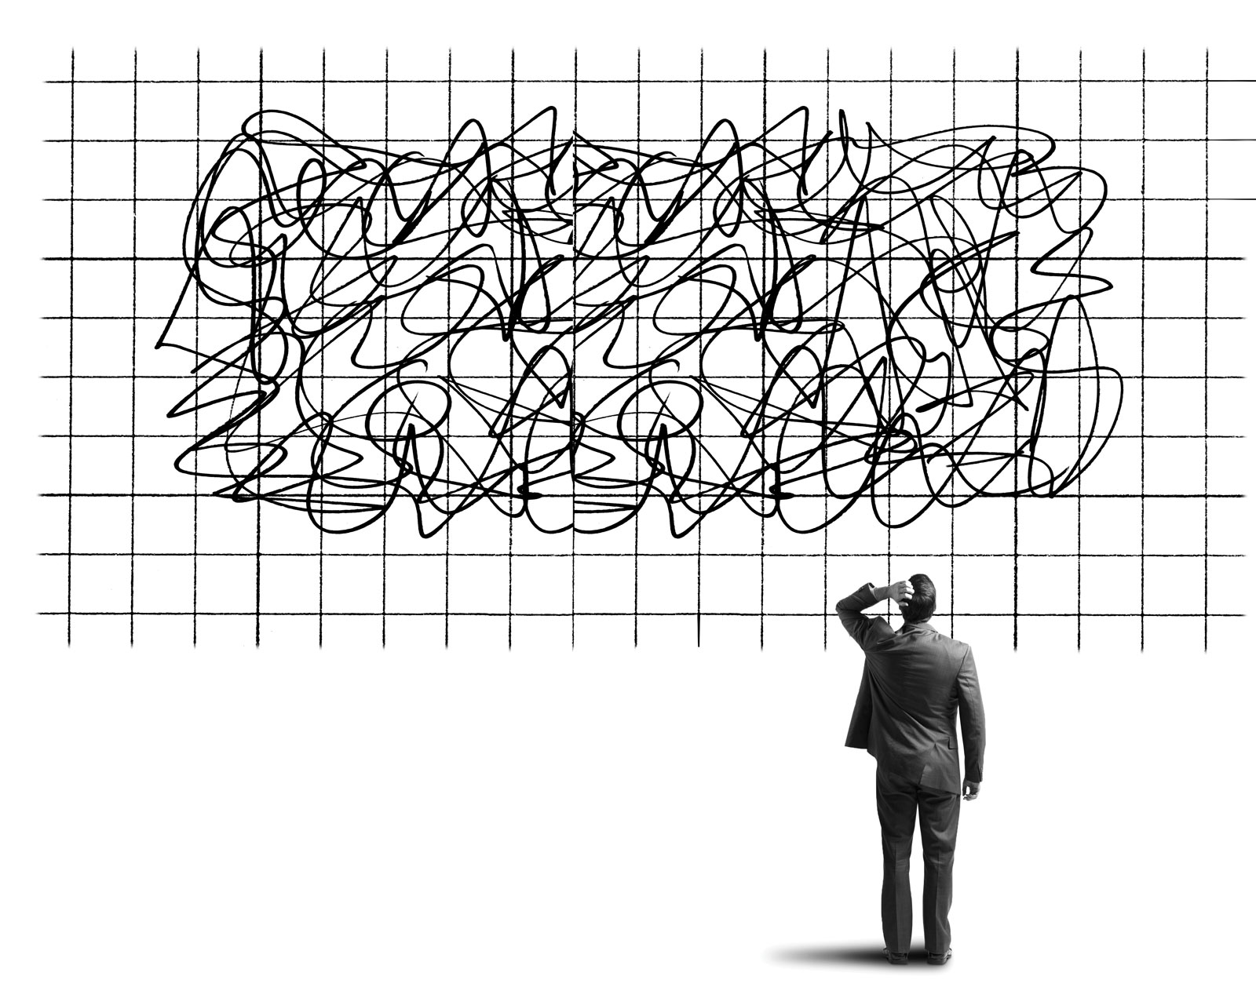


Uncertainty in AI….????

Slide 17
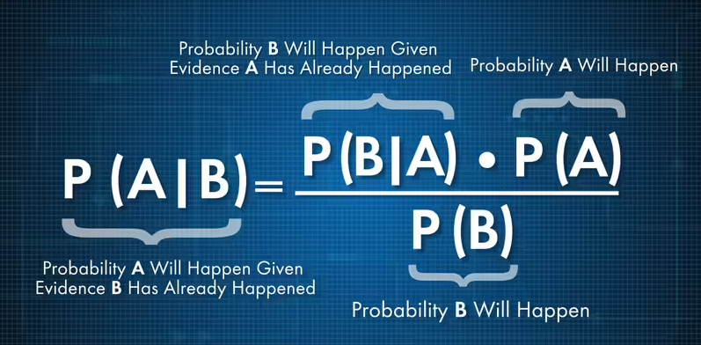
Bayes Theorem :- describes the probability of an event, based on prior knowledge of conditions ...

Slide 18
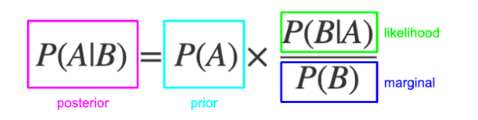
Bayes Theorem

Slide 19
Bayesian network
"A Bayesian network is a probabilistic graphical model which represents a set of variables and their conditional dependencies using a directed acyclic graph."
It is also called a Bayes network, belief network, decision network, or Bayesian model
Bayesian networks are probabilistic, because these networks are built from a probability distribution, and also use probability theory for prediction and anomaly detection.
Bayesian Network can be used for building models from data and experts opinions.
it consists of two parts:
Directed Acyclic Graph
Table of conditional probabilities.

Slide 20
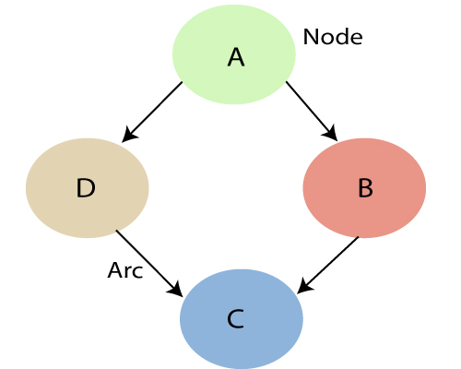
Bayesian network
Each node corresponds to the random variables
Arc or directed arrows represent the causal relationship or conditional probabilities between random variable

Slide 21
Bayesian network
Example: Harry installed a new burglar alarm at his home to detect burglary. The alarm reliably responds at detecting a burglary but also responds for minor earthquakes. Harry has two neighbors David and Sophia, who have taken a responsibility to inform Harry at work when they hear the alarm. David always calls Harry when he hears the alarm, but sometimes he got confused with the phone ringing and calls at that time too. On the other hand, Sophia likes to listen to high music, so sometimes she misses to hear the alarm. Here we would like to compute the probability of Burglary Alarm
Problem:
Calculate the probability that alarm has sounded, but there is neither a burglary, nor an earthquake occurred, and David and Sophia both called the Harry.

Slide 22
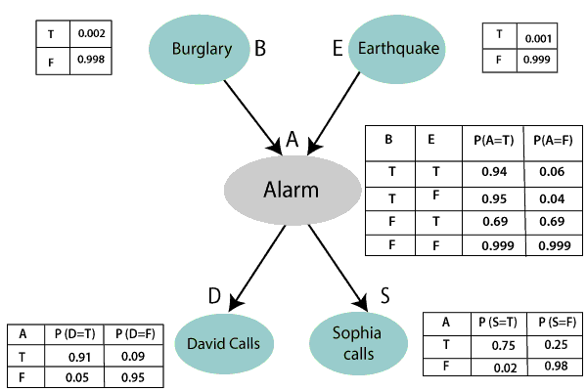
Bayesian network

Slide 23
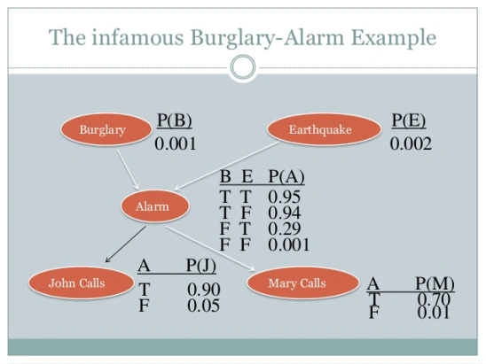
Bayesian network

Slide 24
Bayesian network
Joint probability distribution:
If we have variables x1, x2, x3,....., xn, then the probabilities of a different combination of x1, x2, x3.. xn, are known as Joint probability distribution.
P[x₁, x₂, x₃,....., x_{n}], it can be written as the following way in terms of the joint probability distribution.
= P[x₁| x₂, x₃,....., x_{n}]P[x₂, x₃,....., x_{n}]
= P[x₁| x₂, x₃,....., x_{n}]P[x₂|x₃,....., x_{n}]....P[x_{n-1}|x_{n}]P[x_{n}].

Slide 25
Bayesian network
P[D, S, A, B, E], can rewrite the above probability statement using joint probability distribution:
P[D, S, A, B, E]= P[D | S, A, B, E]. P[S, A, B, E]
=P[D | S, A, B, E]. P[S | A, B, E]. P[A, B, E]
= P [D| A]. P [ S| A, B, E]. P[ A, B, E]
= P[D | A]. P[ S | A]. P[A| B, E]. P[B, E]
= P[D | A ]. P[S | A]. P[A| B, E]. P[B |E]. P[E]

Slide 26
Bayesian network
From the formula of joint distribution, we can write the problem statement in the form of probability distribution:
P(S, D, A, ¬B, ¬E) = P (S|A) *P (D|A)*P (A|¬B ^ ¬E) *P (¬B) *P (¬E).
= 0.75* 0.91* 0.001* 0.998*0.999
= 0.00068045.
Hence, a Bayesian network can answer any query about the domain by using Joint distribution.

Slide 27
Decision Theory
“ Decision theory is the study of principles and algorithms for making correct decisions “
Decisions that allow an agent to achieve better outcomes with respect to its goals. Every action at least implicitly represents a decision under uncertainty: in a state of partial knowledge, something has to be done, even if that something turns out to be nothing (call it "the null action"). Even if you don't know how you make decisions, decisions do get made, and so there has to be some underlying mechanism.
What is it? And how can it be done better? Decision theory has the answers.

Slide 28
Markov Decision Process
“A Markov decision process (MDP) refers to a stochastic decision-making process that uses a mathematical framework to model the decision-making of a dynamic system. “

Slide 29
How does a Markov Decision Process work ?
The MDP model operates by using key elements such as the agent, states, actions, rewards, and optimal policies. The agent refers to a system responsible for making decisions and performing actions. It operates in an environment that details the various states that the agent is in while it transitions from one state to another. MDP defines the mechanism of how certain states and an agent’s actions lead to the other states. Moreover, the agent receives rewards depending on the action it performs and the state it attains (current state).
The MDP framework has the following key components:
S: states (s ∈ S)
A: Actions (a ∈ A)
P (St+1|st.at): Transition probabilities
R (s): Reward

Slide 30
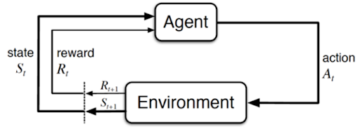
Markov Decision Process
The graphical representation of the MDP model is as follows:

Slide 31
Markov Decision Process
The MDP model uses the Markov Property, which states that the future can be determined only from the present state that encapsulates all the necessary information from the past. The Markov Property can be evaluated by using this equation:
P[St+1|St] = P[St+1 |S1,S2,S3……St]
According to this equation, the probability of the next state (P[St+1]) given the present state (St) is given by the next state’s probability (P[St+1]) considering all the previous states (S1,S2,S3……St).

Slide 32
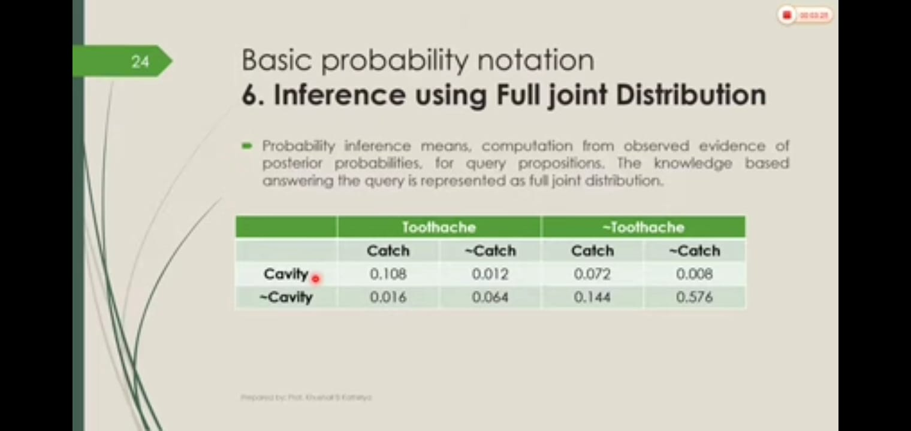
Inference using Full joint distribution

Slide 33
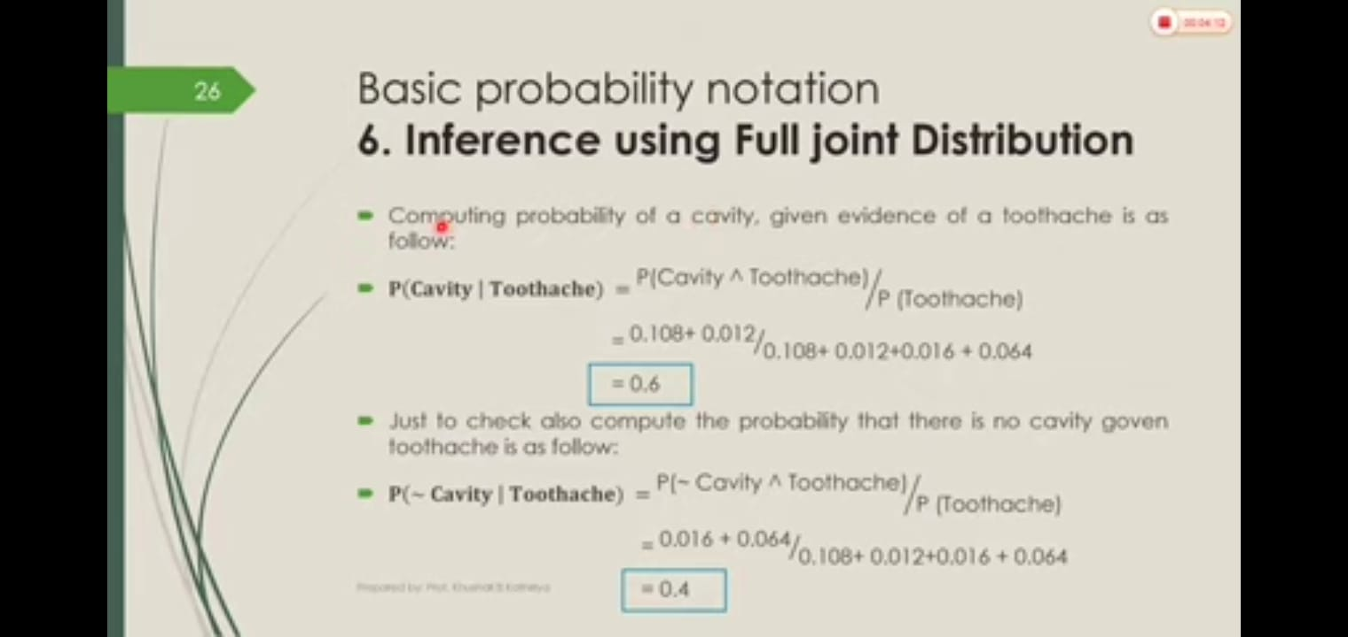
Inference using Full joint distribution

Slide 34
Module 3:
Fuzzy Logic and it’s Applications
Fuzzy Logic ?????

Slide 35
Fuzzy Logic and it’s Applications
Fuzzy Logic : Fuzzy Logic is a form of many-valued logic in which the truth values of variables may be any real number between 0 and 1, instead of just the traditional values of true or false. It is used to deal with imprecise or uncertain information and is a mathematical method for representing vagueness and uncertainty in decision-making.

Slide 36
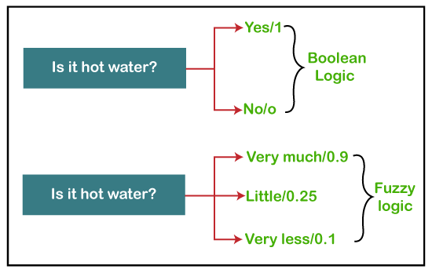
Fuzzy Logic

Slide 37
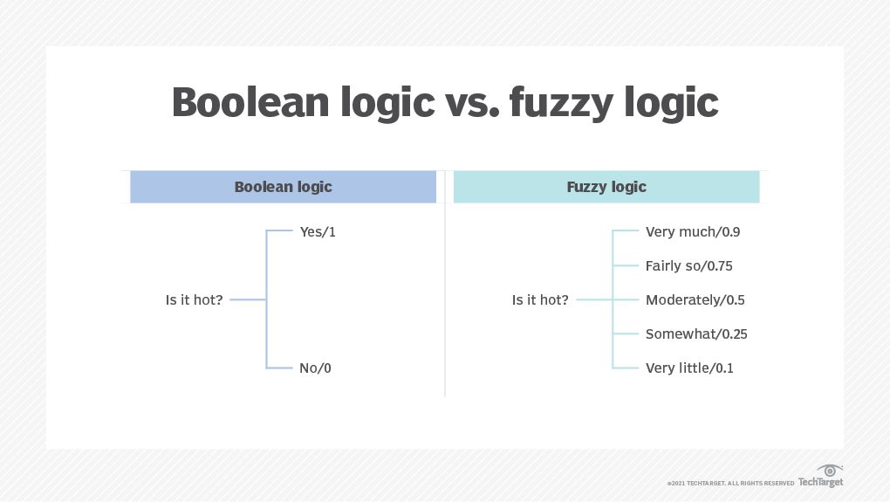
Fuzzy Logic

Slide 38
Fuzzy Logic
Fuzzy Logic Systems (FLS) produce acceptable but definite output in response to incomplete, ambiguous, distorted, or inaccurate (fuzzy) input
Fuzzy Logic (FL) is a method of reasoning that resembles human reasoning. The approach of FL imitates the way of decision making in humans that involves all intermediate possibilities between digital values YES and NO.
CERTAINLY YES
POSSIBLY YES
CANNOT SAY
POSSIBLY NO
CERTAINLY NO

Slide 39
Fuzzy Logic Systems Architecture
It has four main parts as shown −
1> Fuzzification Module − It transforms the system inputs, which are crisp numbers, into fuzzy sets. It splits the input signal into five steps such as −
CERTAINLY YES
POSSIBLY YES
CANNOT SAY
POSSIBLY NO
CERTAINLY NO

Slide 40
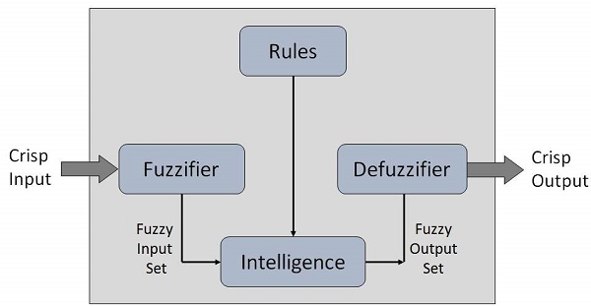
Structure of Fuzzy System
2> Knowledge Base − It stores IF-THEN rules provided by experts.
3> Inference Engine − It simulates the human reasoning process by making fuzzy inference on the inputs and IF-THEN rules.
4> Defuzzification Module − It transforms the fuzzy set obtained by the inference engine into a crisp value.

Slide 41
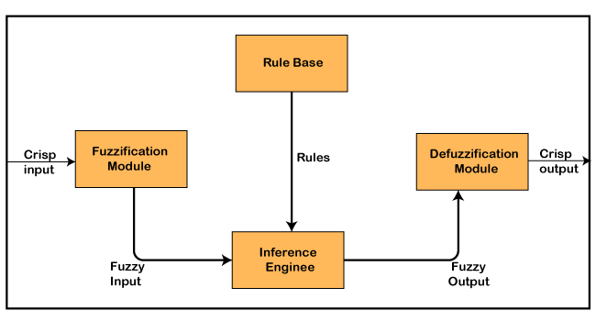
Structure of Mamdani Fuzzy control System

Slide 42
Fuzzy logic applications
1> In automobiles, fuzzy logic is used for gear selection and is based on factors such as engine load, road conditions and style of driving.
2> In dishwashers, fuzzy logic is used to determine the washing strategy and power needed, which is based on factors such as the number of dishes and the level of food residue on the dishes.
3> In copy machines, fuzzy logic is used to adjust drum voltage based on factors such as humidity, picture density and temperature.
4> In aerospace, fuzzy logic is used to manage altitude control for satellites and spacecrafts based on environmental factors.
5> In medicine, fuzzy logic is used for computer-aided diagnoses, based on factors such as symptoms and medical history.

Slide 43
Architecture of Mamdani type Fuzzy Controller
Example1
Fuzzy Controller for Washing Machine

Slide 44
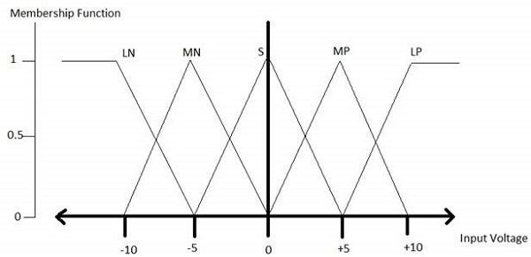
Membership Function
A membership function for a fuzzy set A on the universe of discourse X is defined as μA:X → [0,1].
x axis represents the universe of discourse.
y axis represents the degrees of membership in the [0, 1] interval.

Slide 45
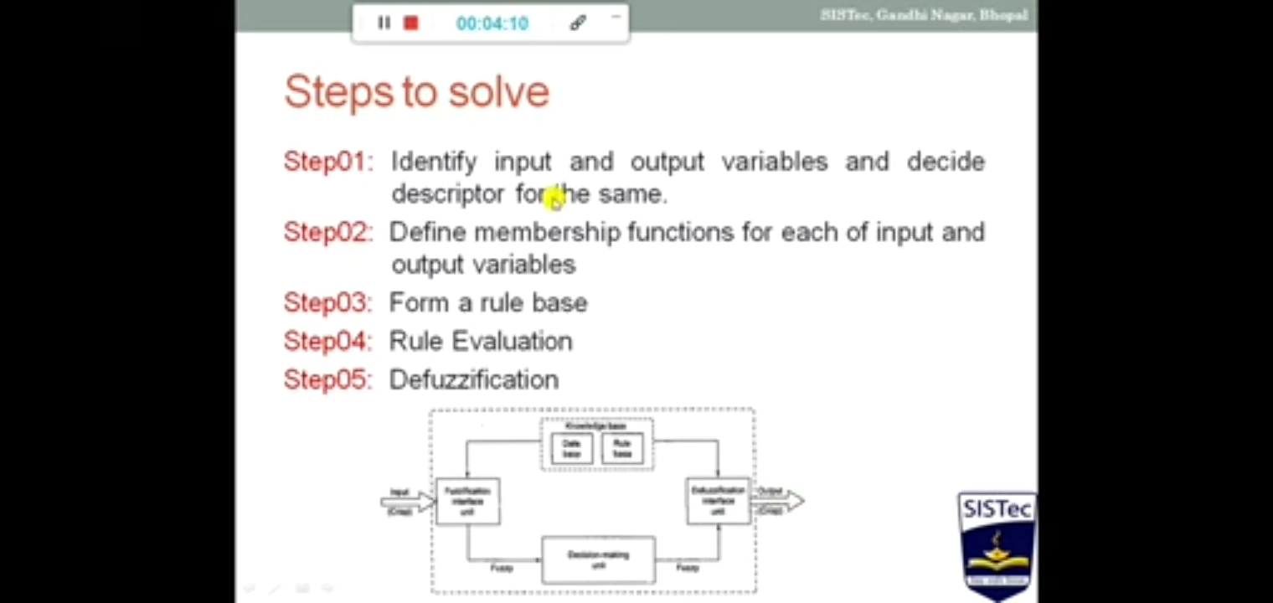

Slide 46
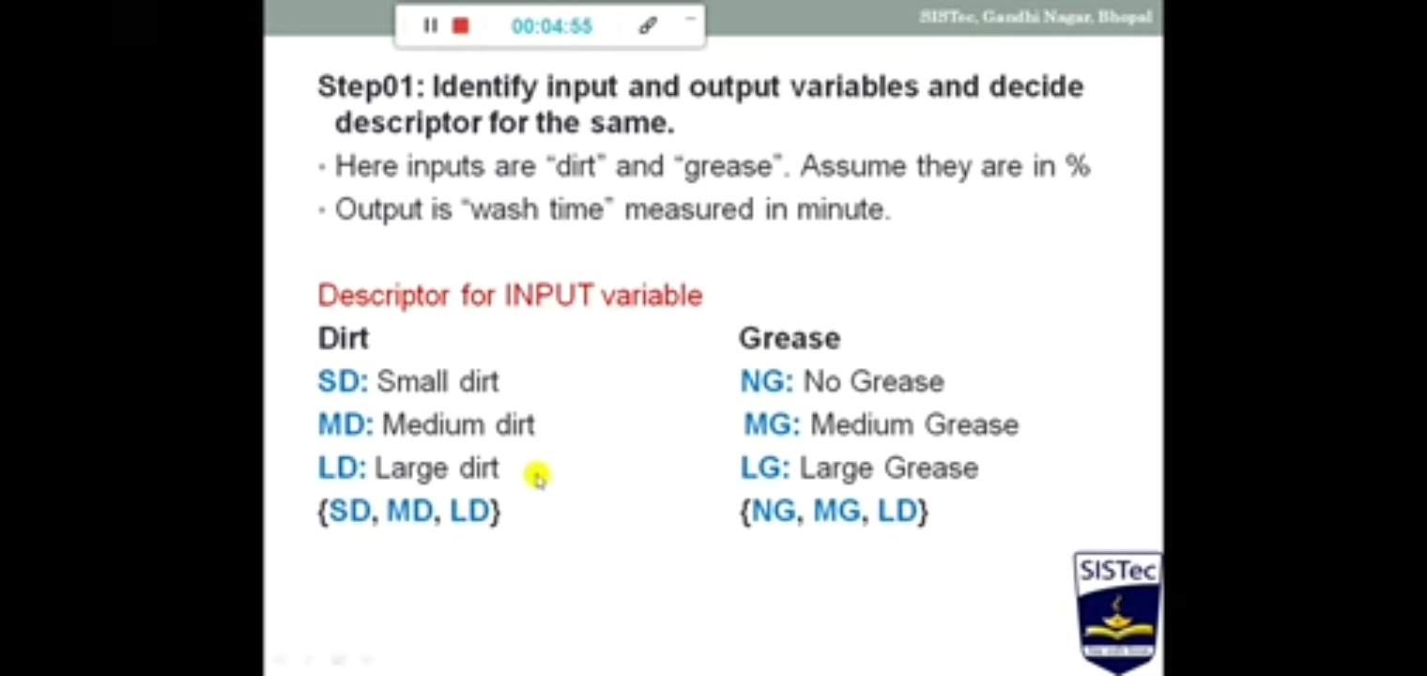

Slide 47
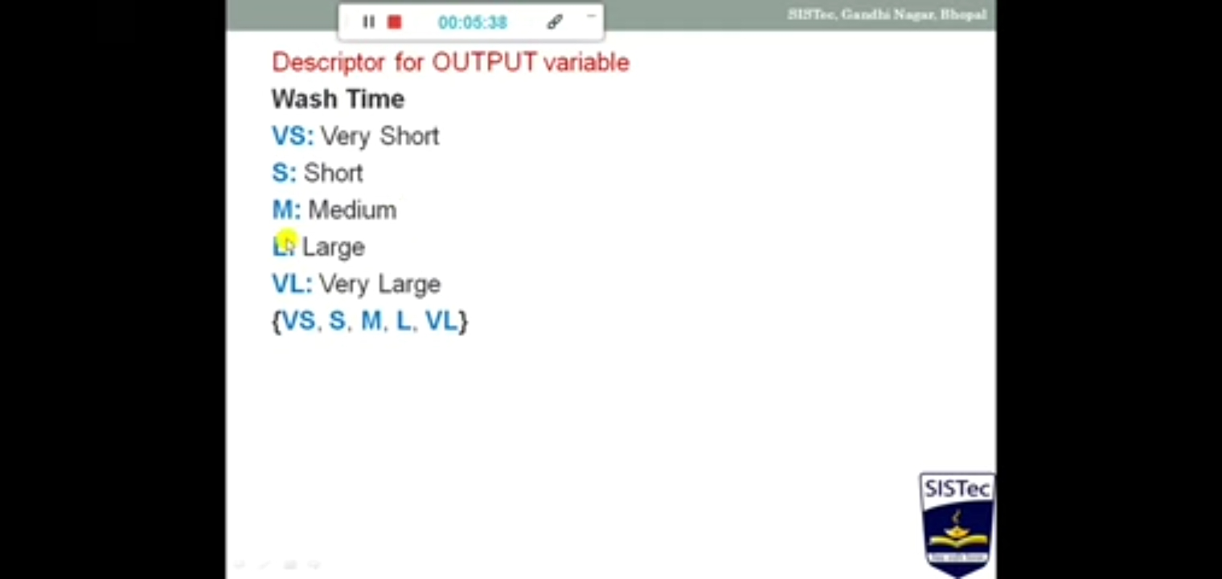

Slide 48
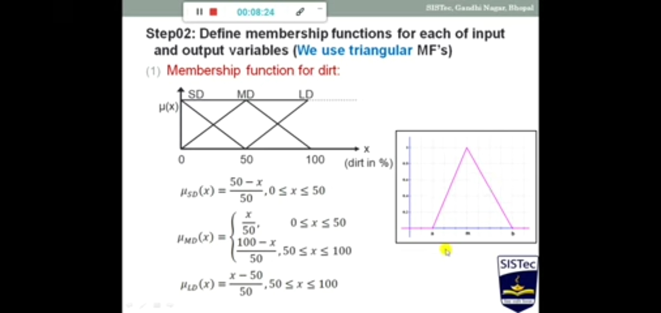

Slide 49
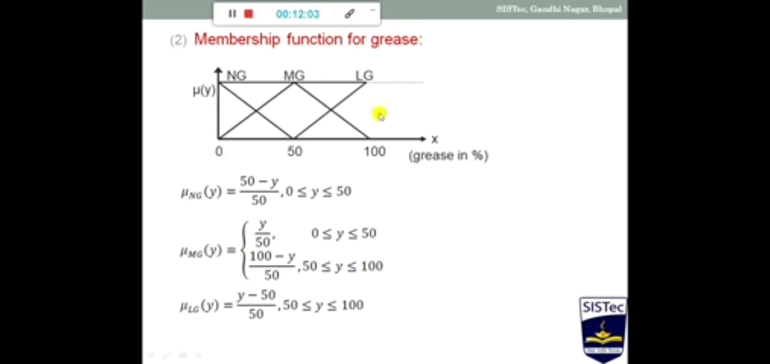

Slide 50
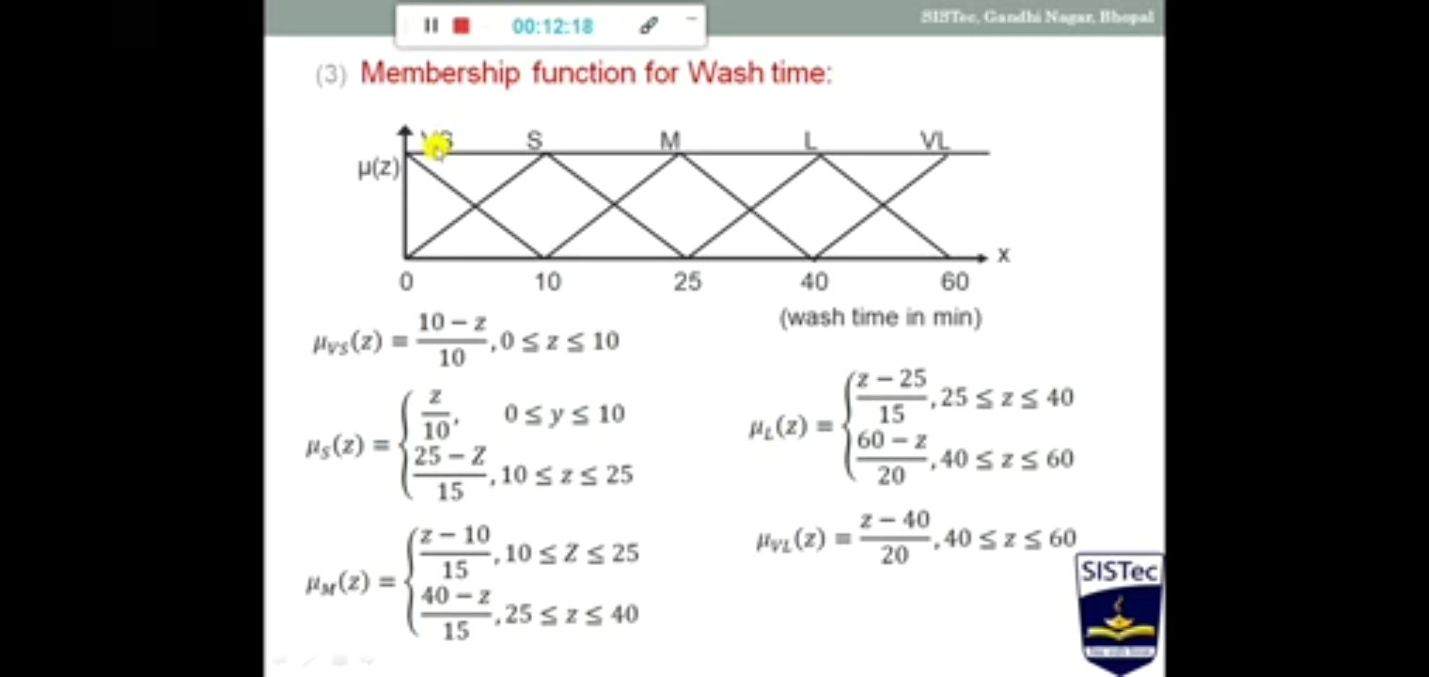

Slide 51
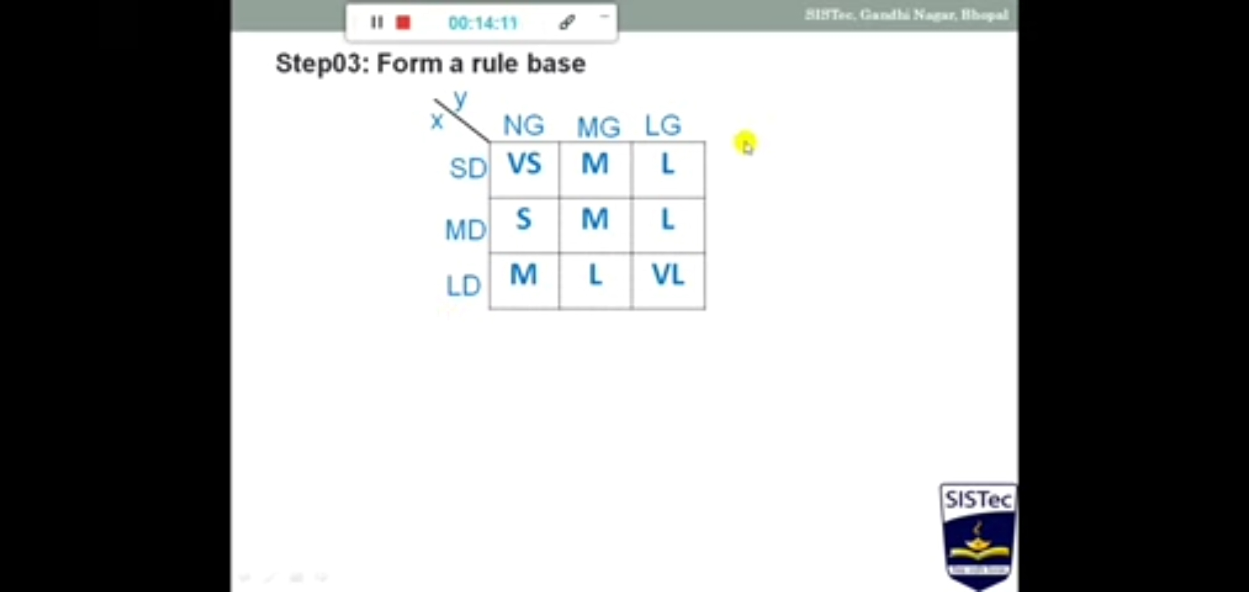

Slide 52
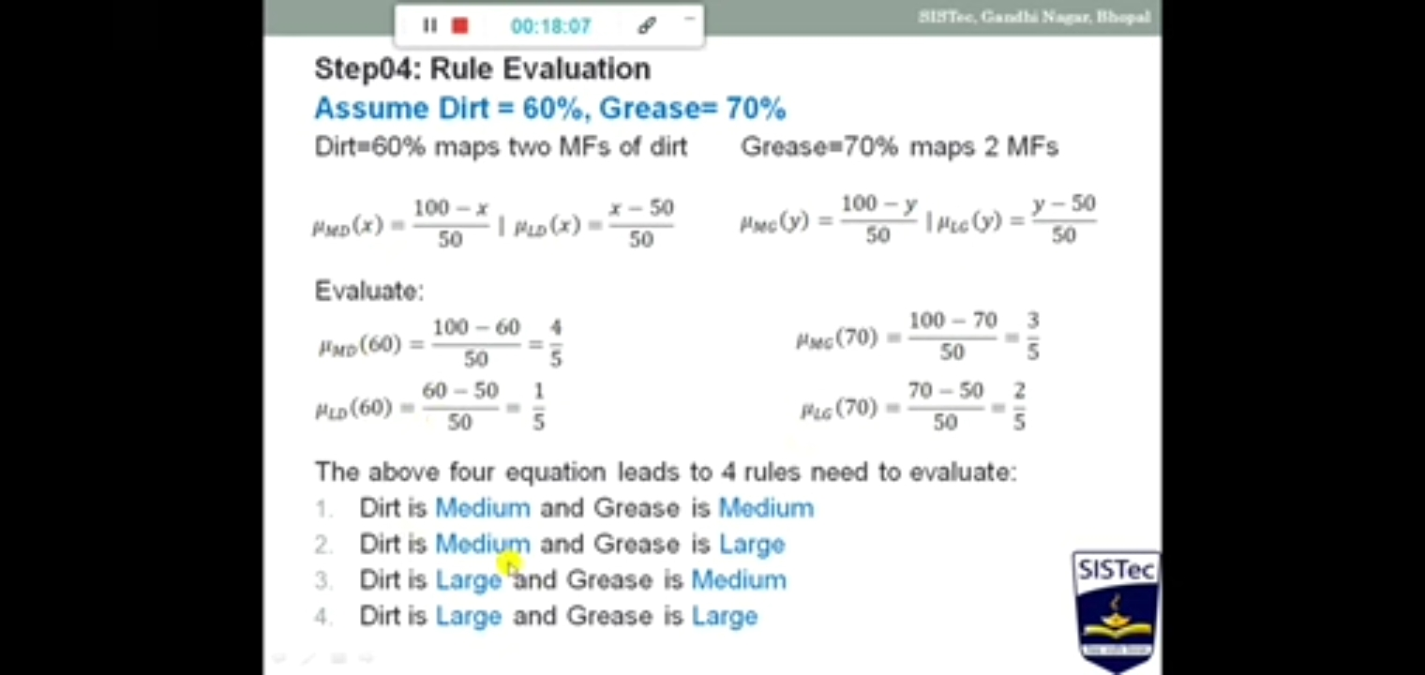

Slide 53
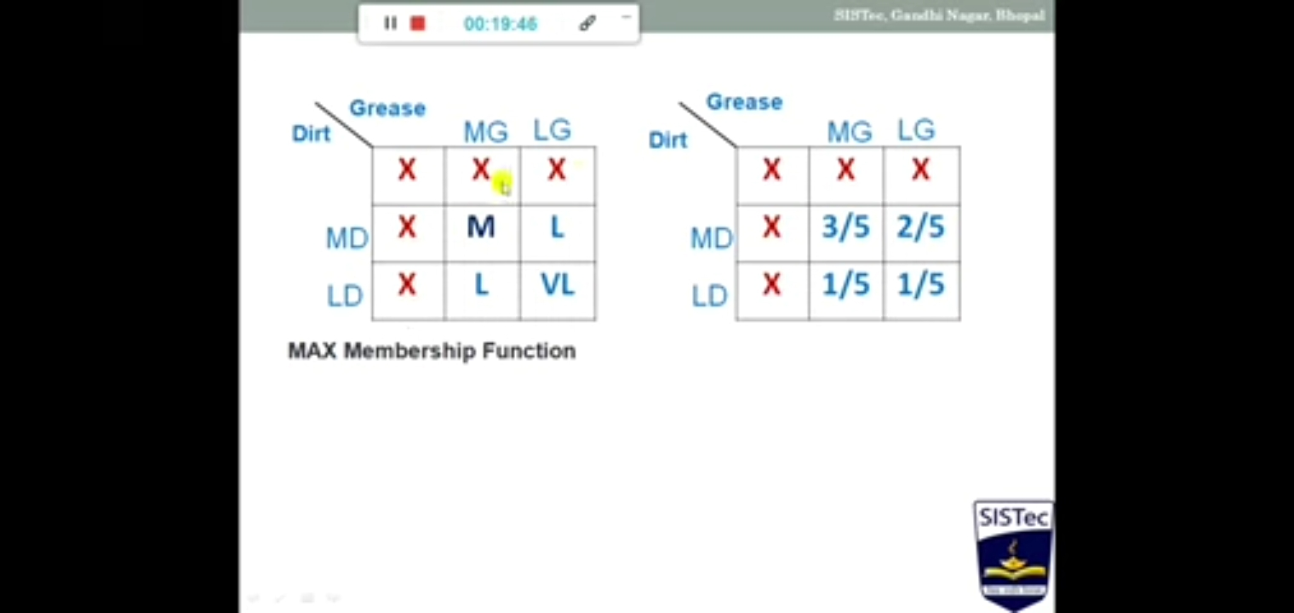

Slide 54
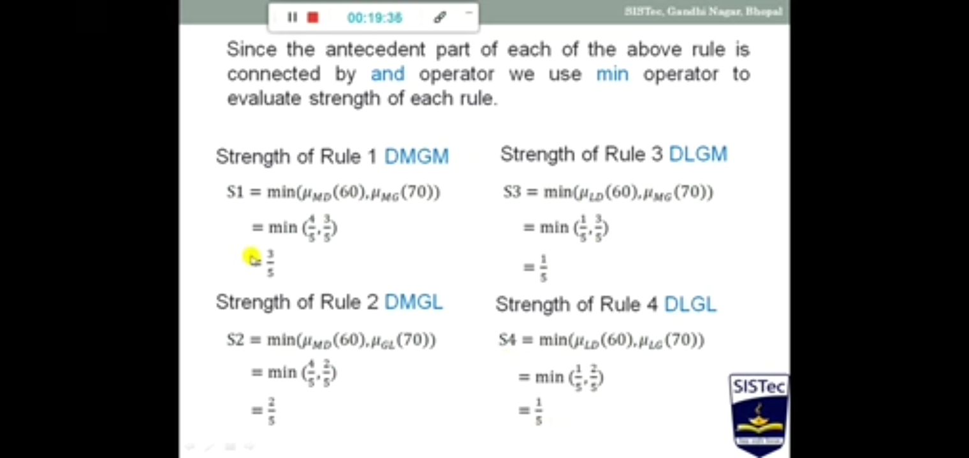

Slide 55
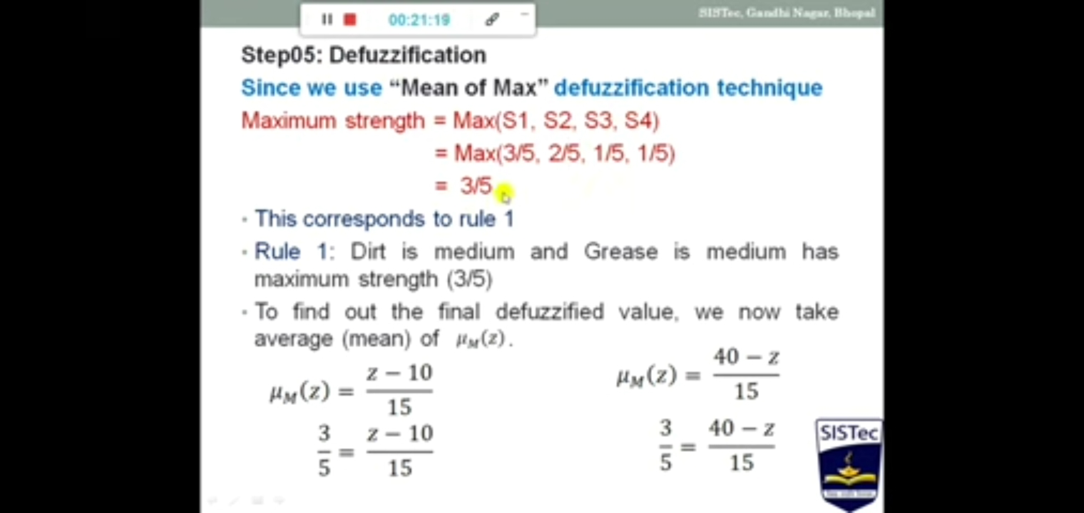

Slide 56
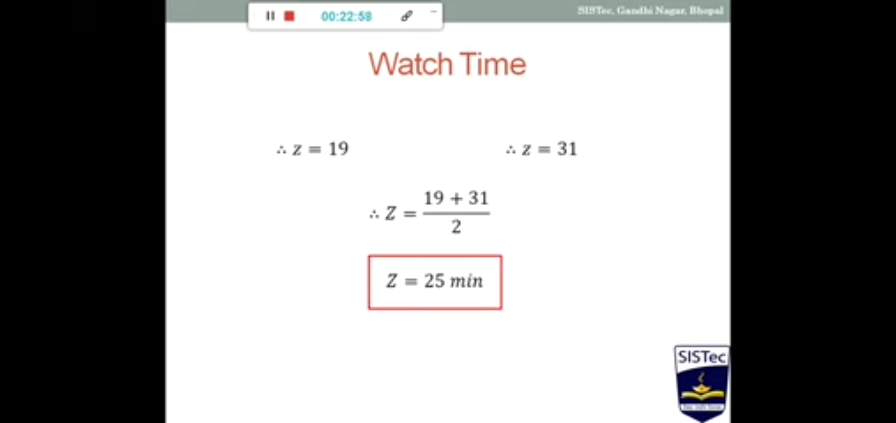

Slide 57
Module 4
Introduction to Deep Learning
Deep Learning ???

Slide 58
Deep Learning
Deep Learning : branch of machine learning that is based on artificial neural network architecture.
An artificial neural network or ANN uses layers of interconnected nodes called neurons that work together to process and learn from the input data.

Slide 59
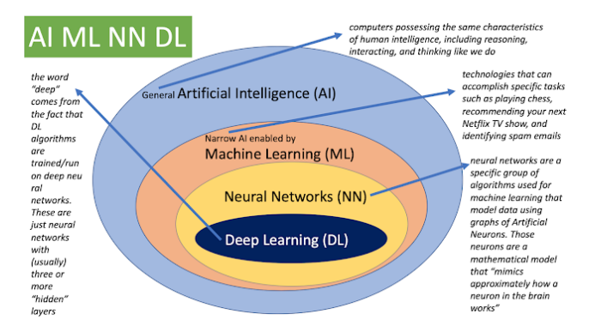
Relation between AI, ML and DL

Slide 60
Deep Learning
Limitations
It only learns through the observations.
It comprises of biases issues.
Advantages
It lessens the need for feature engineering.
It eradicates all those costs that are needless.
It easily identifies difficult defects.
It results in the best-in-class performance on problems.

Slide 61
Deep Learning
Disadvantages
It requires an ample amount of data.
It is quite expensive to train.
It does not have strong theoretical groundwork.

Slide 62
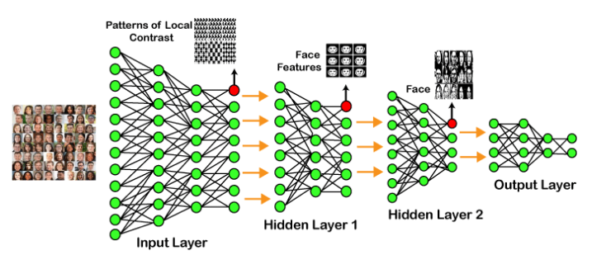
Architecture Of Deep Learning….

Slide 63
Types of Deep Learning Networks
1> Feed forward neural network(1)
2> Recurrent neural network (RNN)
3> Convolution neural network (CNN)
4> Restricted Boltzman Machine
5 > Autoencoders

Slide 64
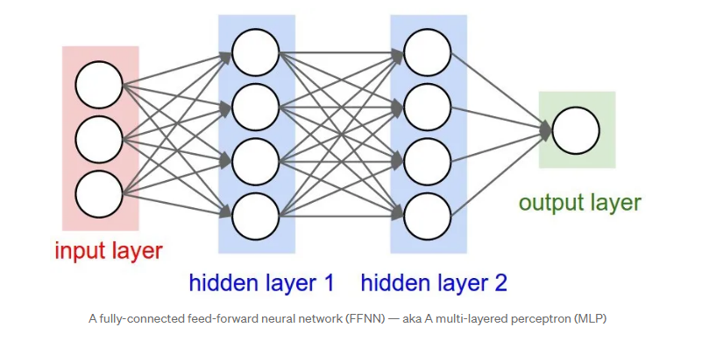
Feed forward neural network
1> nodes do not form a cycle
2> no back-loops in the feed-forward network.
3> the hidden layers do not link with the outside world
4> all of the nodes are fully connected.
https://medium.com/@b.terryjack/introduction-to-deep-learning-feed-forward-neural-networks-ffnns-a-k-a-c688d83a309d
Architecture

Slide 65
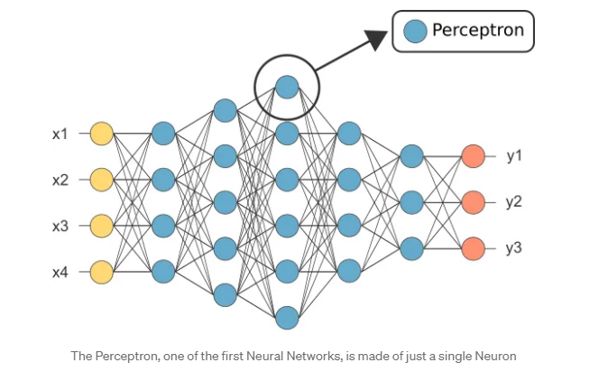
Definitions :
1> Perceptron : A perceptron takes several inputs, processes them using weights and a bias, and produces an output.

Slide 66
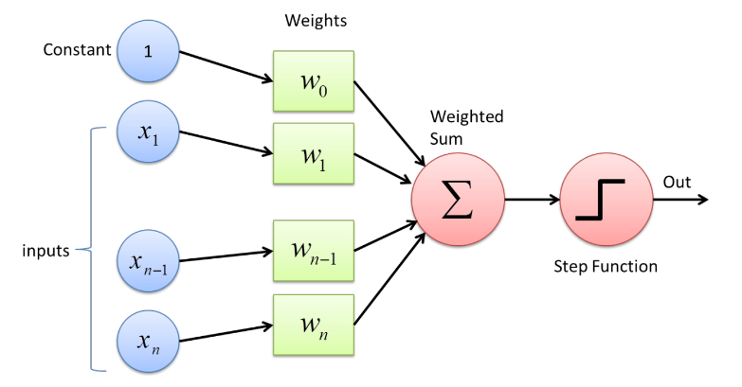
Perceptron : A perceptron takes several inputs, processes them using weights and a bias, and produces an output.

Slide 67
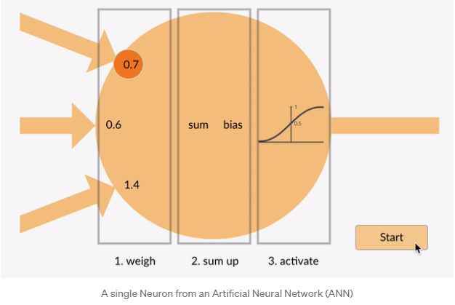

Slide 68
Activation Functions
1. Sigmoid: Maps inputs to a value between 0 and 1. Used for binary classification problems.
2. ReLU (Rectified Linear Unit): Maps all negative values to 0 and all positive values to the same value. Simple and efficient, but can result in "dead" neurons.
3. Tanh (Hyperbolic Tangent): Similar to sigmoid, but maps inputs to a value between -1 and 1.
4. Softmax: Used for multi-class classification problems, outputs a probability distribution over all classes.
5. Leaky ReLU: A variation of ReLU that allows a small gradient when the unit is not active.
6. Swish: A self-gated activation function that can be used as a drop-in replacement for ReLU.
7. ELU (Exponential Linear Unit): Similar to ReLU, but with a smooth transition to negative values.

Slide 69
ReLU (Rectified Linear Unit)
1> ReLU (Rectified Linear Unit) is a simple activation function that:
- Takes all negative values and makes them 0
- Takes all positive values and keeps them the same
ReLU is like a gatekeeper, only allowing positive values to move forward in the network.
Here's a simple example:
Input: -3, 0, 2, -1, 4
Output: 0, 0, 2, 0, 4

Slide 70
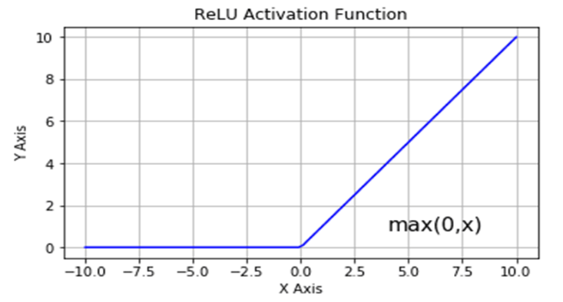
ReLU (Rectified Linear Unit)

Slide 71
sigmoid activation function
Def :- It maps any real-valued number to a value between 0 and 1, making it useful for binary classification problems.
properties of the sigmoid function:
1. Output range: The output of the sigmoid function is always between 0 and
2. S-shape: The sigmoid function has an S-shaped curve, which allows it to model complex relationships between inputs and outputs
3. Monotonic: The sigmoid function is monotonically increasing, meaning that as the input increases, the output also increases.

Slide 72
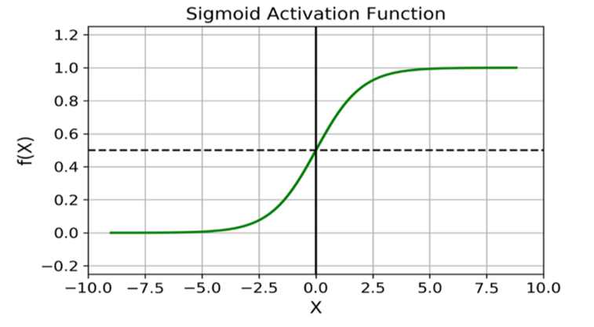
sigmoid activation function

Slide 73
Convolutional Neural Network
Def 1:- A Convolutional Neural Network (ConvNet/CNN) is a Deep Learning algorithm that can take in an input image, assign importance (learnable weights and biases) to various aspects/objects in the image, and be able to differentiate one from the other.[2]
Def2:- A CNN is a neural network that uses convolutional and pooling layers to extract features from data with grid-like topology, such as images.

Slide 74
Convolutional Neural Network
Key Components:
1. Convolutional Layers: These layers apply filters to small regions of the input data, scanning the data in a sliding window fashion. This helps detect local patterns and features.
2. Activation Functions: ReLU (Rectified Linear Unit) or other activation functions are applied to the output of convolutional layers to introduce non-linearity.
3. Pooling Layers: These layers downsample the data, reducing spatial dimensions while retaining important features.
4. Flatten Layer: This layer flattens the output of convolutional and pooling layers into a 1D array for further processing.
5. Dense Layers: Fully connected layers that perform classification or regression tasks.

Slide 75
How CNNs Works:
1. Convolution: Filters scan the input data, computing dot products to generate feature maps.
2. Activation: Activation functions introduce non-linearity to the feature maps.
3. Pooling: Downsampling reduces spatial dimensions, retaining important features.
4. Flattening: The output is flattened into a 1D array.
5. Classification/Regression: Dense layers perform the final task.

Slide 76
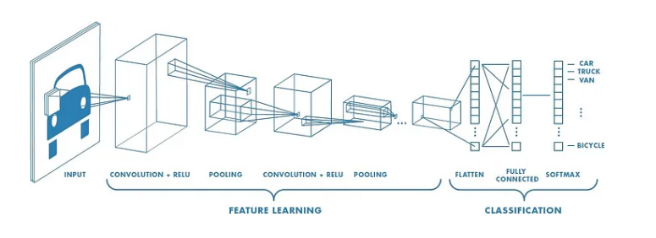
Architecture of CNN

Slide 77
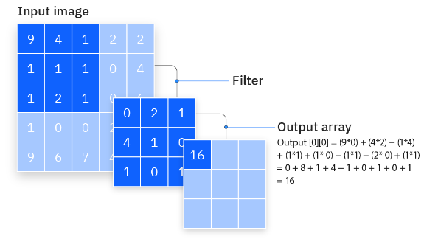
Convolutional layer Operations

Slide 78
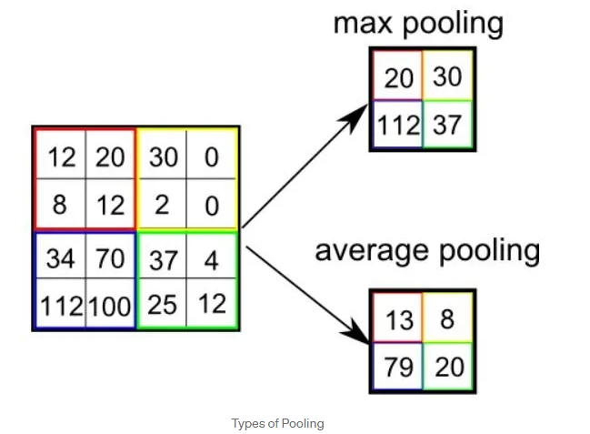
Pooling Operations in CNN
Types of Pooling

Slide 79
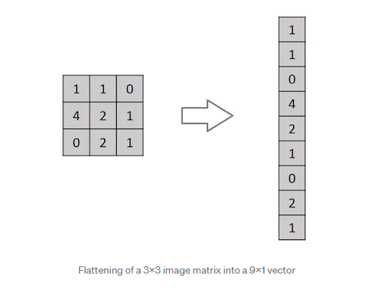
Flattening Operations in CNN

Slide 80
Applications of CNN
1. Image Classification: CNNs excel in image classification tasks, such as object recognition.
2. Object Detection: CNNs are used in object detection tasks, like bounding box prediction.
3. Image Segmentation: CNNs help segment images into regions of interest.
4. Video Analysis: CNNs are applied to video analysis tasks, such as action recognition.

Slide 81
Challenges and Limitations:[3]
1. Computational Cost: CNNs can be computationally expensive.
2. Overfitting: CNNs can suffer from overfitting,
3. Interpretability: Understanding CNN decisions can be challenging.

Slide 82
Recurrent Neural Networks
Motivation/Need : If you want to make predictions on sequential or time series data (e.g., text, audio, etc.) traditional neural networks are a bad choice. But why?
In time series data, the current observation depends on previous observations, and thus observations are not independent from each other. Traditional neural networks, however, view each observation as independent as the networks are not able to retain past or historical information. Bascially, they have no memory of what happend in the past.

Slide 83
Recurrent Neural Networks
Def:- Recurrent Neural Network(RNN) is a type of Neural Network where the output from the previous step is fed as input to the current step.
With this, RNNs can be trained to remember concepts based on context, i.e., learn repeated patterns.

Slide 84
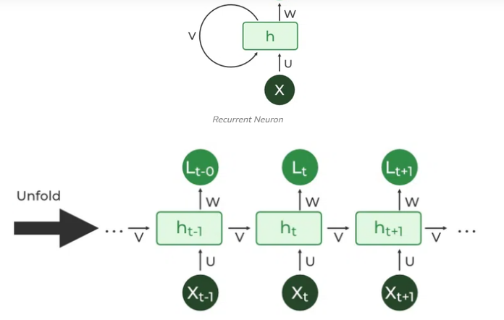
Architecture of RNN

Slide 85
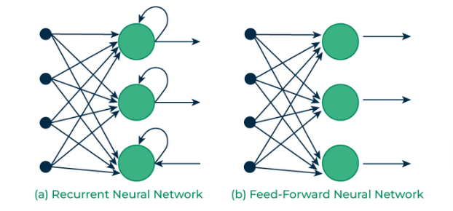
RNN Vs FFNN

Slide 86
Types Of RNN[4]
There are four types of RNNs based on the number of inputs and outputs in the network.
One to One (simple Neural network)
One to Many ( Image captioning)
Many to One (sentimental analysis)
Many to Many ( language translation )

Slide 87
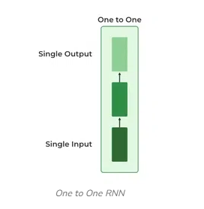
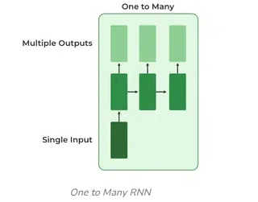
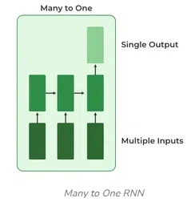
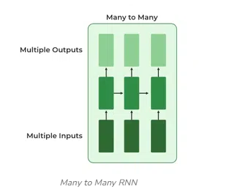
Types Of RNN[4]

Slide 88
LSTM(Long Short Term Memory)
> A long short-term memory network is a type of recurrent neural network (RNN).
> LSTMs are predominantly used to learn, process, and classify sequential data because these networks can learn long-term dependencies between time steps of data.
>applications include sentiment analysis, language modeling, speech recognition, and video analysis.

Slide 89
LSTM(Long Short Term Memory)
Key Components:
1. Input Gate: Controls the flow of new information into the cell.
2. Cell State: The internal memory of the RNN, capturing information over time.
3. Output Gate: Controls the output of the RNN, based on the cell state.
4. Forget Gate: Decides what information to discard from the cell state.

Slide 90
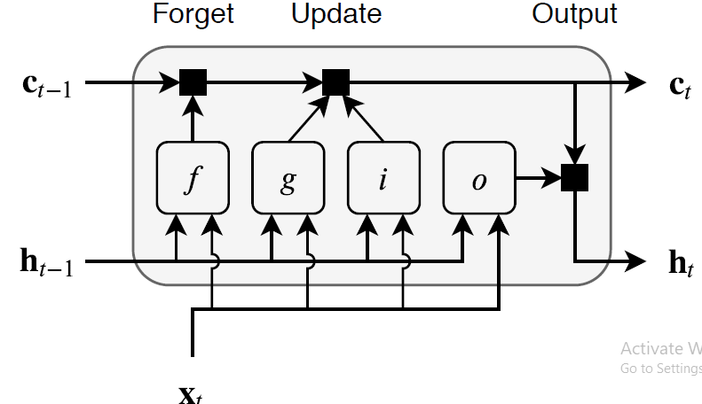
Architecture of LSTM [4]

Slide 91
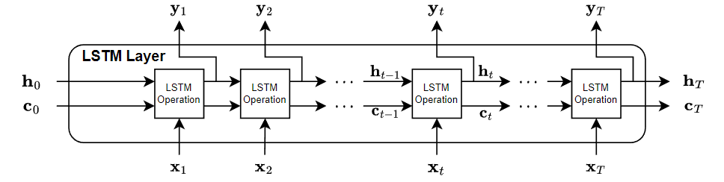
LSTM Layered Architecture…

Slide 92
Autoencoders
Def : An Autoencoder is a type of neural network that can learn to reconstruct images, text, and other data from compressed versions of themselves.(e .g lecture )*
It consists of 3 layers
1> Encoder
2> Code/bottleneck
3> Decoder

Slide 93

Architecture of Autoencoder

Slide 94

Example

Slide 95
applications of autoencoders:
1> Autoencoders are used largely for anomaly detection:
2> Autoencoders are used for Noise Removal:
3> Autoencoders as Generative models:

Slide 96
Types of Autoencoders
1> Denoising Autoencoder
2> Sparse Autoencoder
3> Convolutional Autoencoder

Slide 97
Denoising Autoencoder
Denoising autoencoder works on a partially corrupted input and trains to recover the original undistorted image( e.g facial imag edrawing)
Advantages
This type of autoencoder can extract important features and reduce the noise or the useless features.
Denoising autoencoders can be used as a form of data augmentation, the restored images can be used as augmented data thus generating additional training samples.
Disadvantages
Selecting the right type and level of noise to introduce can be challenging and may require domain knowledge.
Denoising process can result into loss of some information that is needed from the original input. This loss can impact accuracy of the output.

Slide 98
Sparse Autoencoder
This type of autoencoder typically contains more hidden units than the input but only a few are allowed to be active at once. This property is called the sparsity of the network
Advantages
The sparsity constraint in sparse autoencoders helps in filtering out noise and irrelevant features during the encoding process.
These autoencoders often learn important and meaningful features due to their emphasis on sparse activations.
Disadvantages
The choice of hyperparameters play a significant role in the performance of this autoencoder. Different inputs should result in the activation of different nodes of the network.
The application of sparsity constraint increases computational complexity.

Slide 99
Convolutional Autoencoder
It is a type of autoencoder that use convolutional neural networks (CNNs) as their building blocks. The encoder consists of multiple layers that take a image or a grid as input and pass it through different convolution layers thus forming a compressed representation of the input. The decoder is the mirror image of the encoder it deconvolves the compressed representation and tries to reconstruct the original image.(e.g lecture)
Advantages
Convolutional autoencoder can compress high-dimensional image data into a lower-dimensional data. This improves storage efficiency and transmission of image data.
Convolutional autoencoder can reconstruct missing parts of an image.
Disadvantages
These autoencoder are prone to overfitting. Proper regularization techniques should be used to tackle this issue.
Compression of data can cause data loss which can result in reconstruction of a lower quality image.

Slide 100
References
1) https://medium.com/@b.terryjack/introduction-to-deep-learning-feed-forward-neural-networks-ffnns-a-k-a-c688d83a309d
2) https://towardsdatascience.com/a-comprehensive-guide-to-convolutional-neural-networks-the-eli5-way-3bd2b1164a53
3) https://www.linkedin.com/pulse/what-convolutional-neural-network-cnn-deep-learning-nafiz-shahriar
4)
https://www.geeksforgeeks.org/introduction-to-recurrent-neural-network/

Slide 101
5>https://www.mathworks.com/help/deeplearning/ug/long-short-term-memory-networks.html

